Slide 1

COLOUR DETECTION
SRM INSTITUTE OF SCIENCE AND TECHNOLOGY
SCHOOL OF COMPUTING
DEPARTMENT OF COMPUTING TECHNOLOGIES
18CSP107L / 18CSP108L - MINOR PROJECT / INTERNSHIP
Batch ID: B269
Student 1 Reg. No:RA1911003010236
Student 1 Name:Ambuj Porwal
Student 2 Reg. No:RA1911003010238
Student 2 Name:Sajal Tyagi
Guide name: Dr.R Rajkamal Designation:Ass.Professor

Slide 2
Abstract
Colour detection is the process of detecting name of the colour. Here this is easy task for humans to detect the colour and choose one.
We are going to build an application through which you can automatically get the name of the color by clicking on them. So for this, we will have a data file that contains the color name and its values. Then we will calculate the distance from each color and find the shortest one.

Slide 3

Table of Content
01
02
03
04
Abstract
Literature Survey
Methodology
Merits And Demerits
07
06
05
Screenshots and references
Architecture Diagram And Module Discription
Problem Statement and Objective

Slide 4
LITERATURE SURVEY
YEAR | PUBLICATION DETAILS | APPROACH
2017 | Su, Feng, Gu Fang, and Ju Jia Zou. "A novel colour model for colour detection." Journal of Modern Optics 64, no. 8 (2017): 819-829. | The proposed colour model is called the HPBr colour model. It is converted from the RGB colour model and it consists of three colour components, namely, hue (H), purity (P) and brightness (Br).

Slide 5
2015 | Sawicki, Dariusz J., and Weronika Miziolek. "Human colour skin detection in CMYK colour space." IET Image Processing 9, no. 9 (2015): 751-757. | Its properties seem the most appropriate for the task of skin colour detection. Some experiments have been worked out using Compaq Database – a large database of skin and non-skin photos. A comparison of the new method against well-known thresholding methods in RGB, YCbCr and HSV spaces were prepared.

Slide 6
2021 | Tariq, Abdullah, Muhammad Zeeshan Khan, and Muhammad Usman Ghani Khan. "Real Time Vehicle Detection and Colour Recognition using tuned Features of Faster-RCNN." In 2021 1st International Conference on Artificial Intelligence and Data Analytics (CAIDA), pp. 262-267. IEEE, 2021. | Then the proposed model detect the vehicle and classify its colour. In addition to this, statistical report is also generated that infer, which colour of vehicles are being detected in the specific amount of time.

Slide 7
1994 | Matas, Jirí, Radek Marík, and Josef Kittler. "Illumination Invariant Colour Recognition." In BMVC, vol. 94, pp. 469-479. 1994. | A colour based recognition system with three novel features. Firstly, the proposed system can operate in environments with spectrally uneven and changing illumination. Secondly, benets in terms of speed and quality of output are gained by focusing processing to areas of salient colour. Finally, an automatic model acquisition procedure has been implemented.

Slide 8
2015 | B. R. Navada, K. V. Santhosh, S. Prajwal and H. B. Shetty, "An image processing technique for color detection and distinguish patterns with similar color: An aid for color blind people," International Conference on Circuits, Communication, Control and Computing, 2014, pp. 333-336, doi: 10.1109/CIMCA.2014.7057818. | Image Processing Technique is used in proposed work to develop a setup for identifying the colours in an image and indicating the edges in case of different images with similar colours. Image processing involves two parts, first is colour detection and second is edge detection.

Slide 9
Methodology
NAÏVE BAYES ALGORITHM :
Naïve Bayes algorithm is a supervised learning algorithm, which is based on Bayes theorem and used for solving classification problems.It is mainly used in text classification that includes a high-dimensional training dataset.
Naïve Bayes Classifier is one of the simple and most effective Classification algorithms which helps in building the fast machine learning models that can make quick predictions.
It is a probabilistic classifier, which means it predicts on the basis of the probability of an object.
Some popular examples of Naïve Bayes Algorithm are spam filtration, Sentimental analysis, and classifying articles.
K MEANS ALGORITHM :
K-Means Clustering is an unsupervised learning algorithm that is used to solve the clustering problems in machine learning or data science.
It allows us to cluster the data into different groups and a convenient way to discover the categories of groups in the unlabeled dataset on its own without the need for any training.
The main aim of this algorithm is to minimize the sum of distances between the data point and their corresponding clusters.
The algorithm takes the unlabeled dataset as input, divides the dataset into k-number of clusters, and repeats the process until it does not find the best clusters.

Slide 10
GAUSSIAN PYRAMID :
The Gaussian pyramid is a technique in image processing that breaks down an image into successively smaller groups of pixels to blur it. It is named after German mathematician Johann Carl Friederich Gauss. This type of precise mathematical blurring is used extensively in artificially intelligent computer vision as a pre-processing step. For instance, when a digital photograph is blurred in this way, edges of objects are easier to detect, enabling a computer to identify them automatically.
LAPLACIAN PYRAMID :
The Laplacian pyramid, originally proposed by Burt and Adelson before multiresolution wavelet analysis was introduced, is a bandpass image decomposition derived from the Gaussian pyramid (GP) which is a multiresolution image representation obtained through a recursive reduction (low pass filtering and decimation) of the image data set.

Slide 11
MERITS
We can upload photos from our gallery and can capture an image too and use it for detection of colour.
We can use camera to detect live colour for any object.
It gives fast response.
It is removing the dirtiness(dullness) . In other word it enhances the colour of given picture.

Slide 12
DEMERITS
There will be around 16.5M combinations but we are considering only 865 combinations only.
It does not have proper application right now.
It is still in development.
We are still working to remove blurness.

Slide 13

PROBLEM STATEMENT
We are making this project to help colour blind people, And If you have color blindness, then it means you see colors differently than most people.
Problems -
First we have to Enhance the colours of given picture.
Exactly this problem colour blind people face in their day to day life.
This project with image enhancement is very helpful for futuristic self drive cars which needs detect the middle white tape for safe driving.

Slide 14
OUR OBJECTIVE
END USERS(TARGET)
To help the colour blind people .
FIRST APPROACH
Here , Our First Approach is to Enchance the colour of the given picture to bring back the true colours.
SECOND APPROACH
By Normal Mode,In thatThey can input the image and get the colour name of desired area.
By Live Mode,With the help of that mode they can identify colour in video mode.

Slide 15
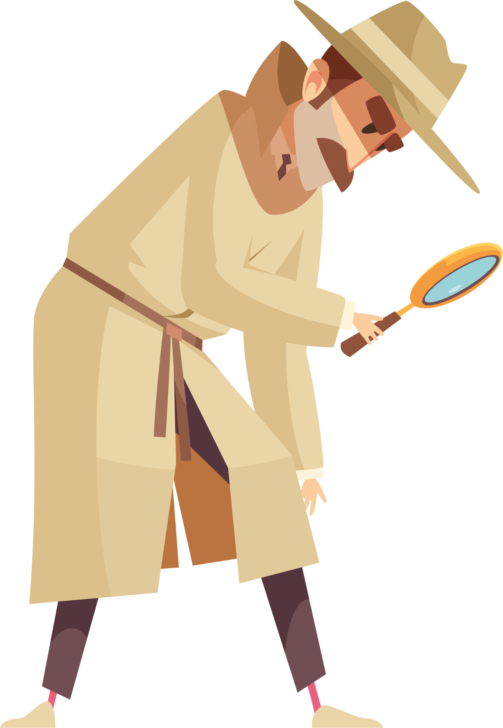
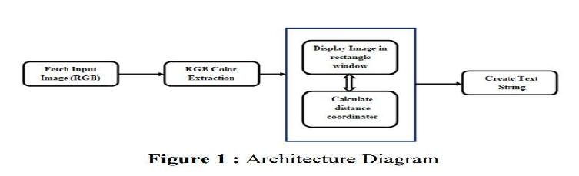
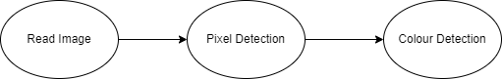
ARCHITECTURE DIAGRAM AND BLOCK DIAGRAM

Slide 16
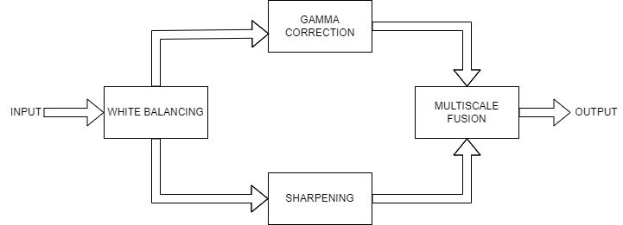

Slide 17
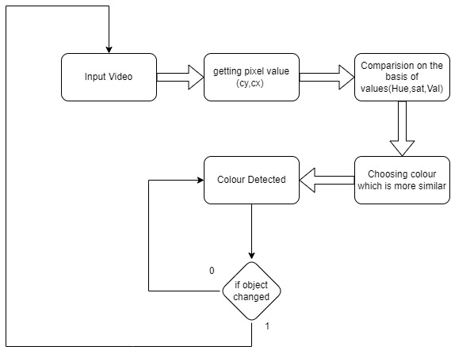

Slide 18
MODULE DISCRIPTION
Here , We are dividing our project into three modules ->
Image Colour Enhancing - In this given picture/Image will enhanced before going for colour detection. In other words we will try to bring back its true colour of that picture/image. And the colour Enhancing of image is being done with the help of MATLAB.
Normal(Image type) - In this type,We are taking image as input and wherever we hover cursor and click on particular point then it will show the colour for that particular point.
Result - We will be able to get the colour for image type model.
Live(Camera Type) - In this type,We have a working camera and we will create a center pixel point . Whenever we put any object in line of sight of that center then it show the colour of that object.
Result - We will be able to get the colour of object by Live module.

Slide 19
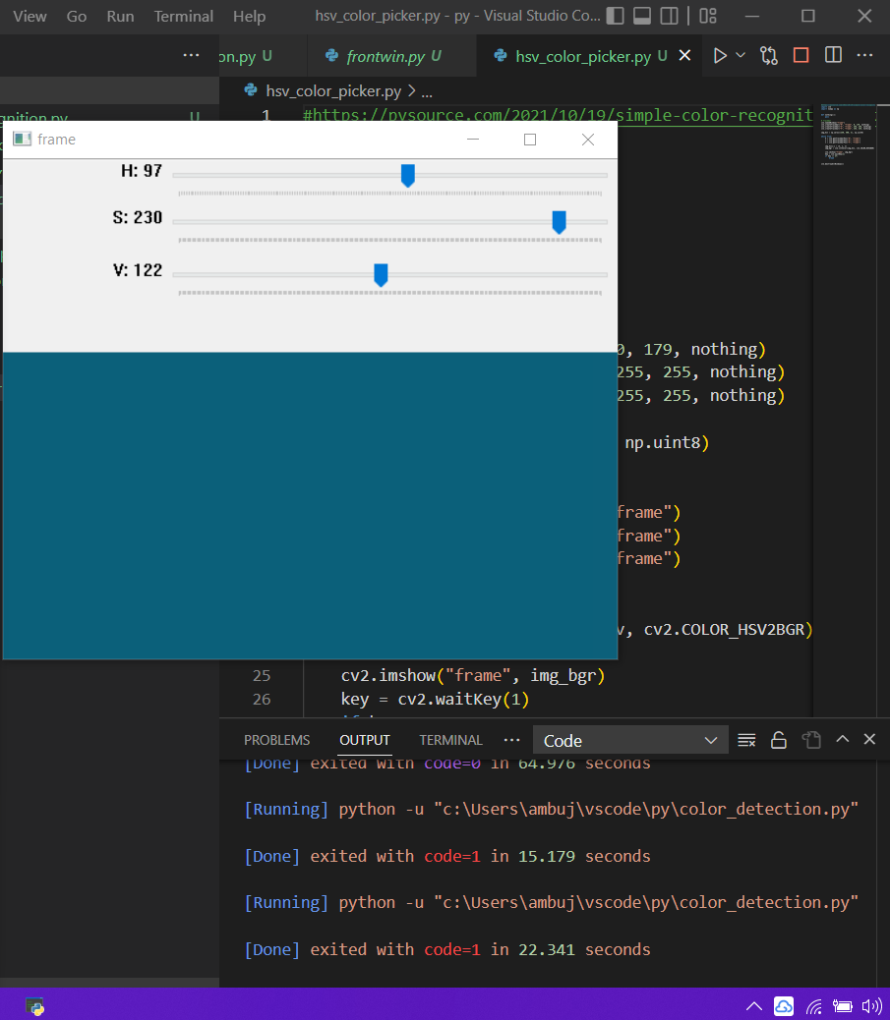
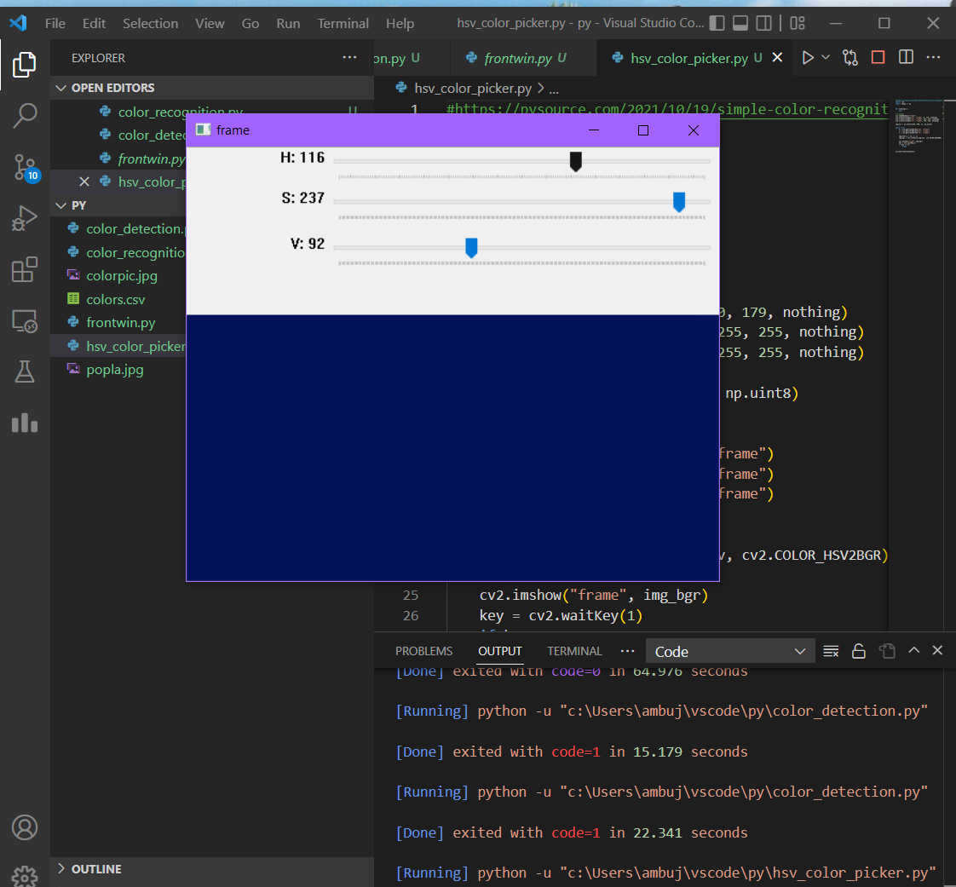
Screenshots

Slide 20
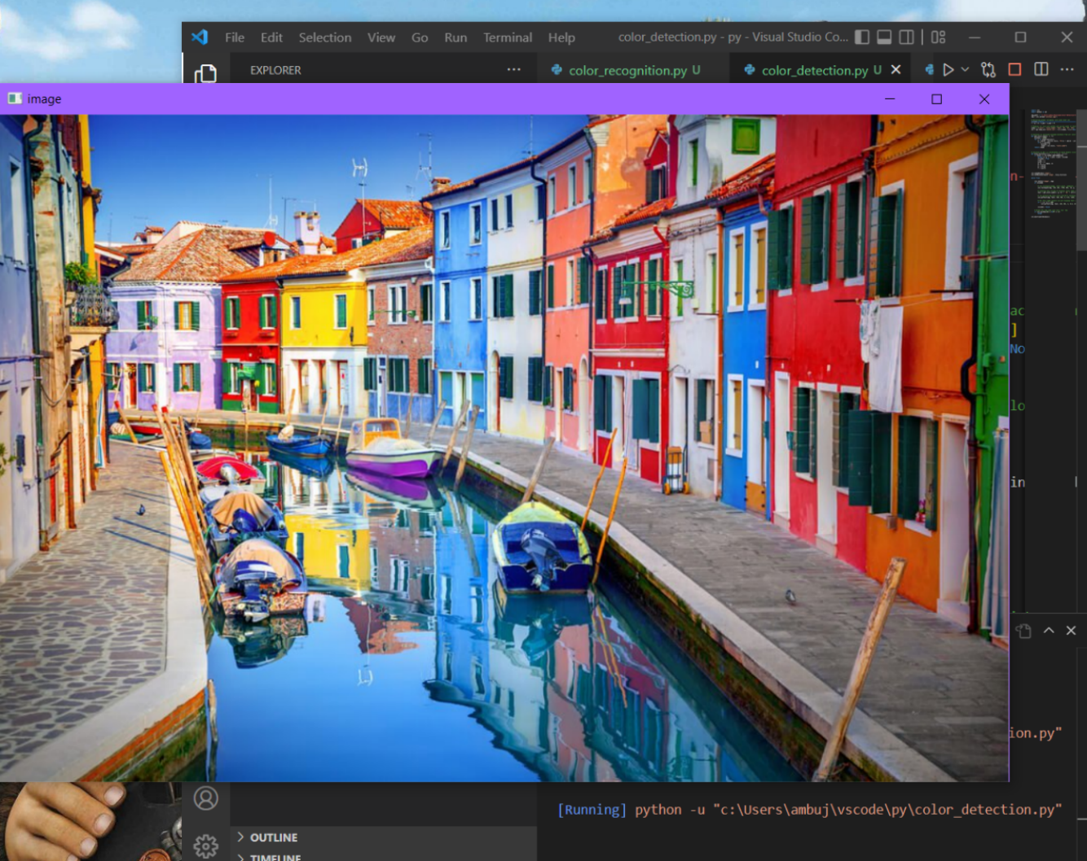

Slide 21
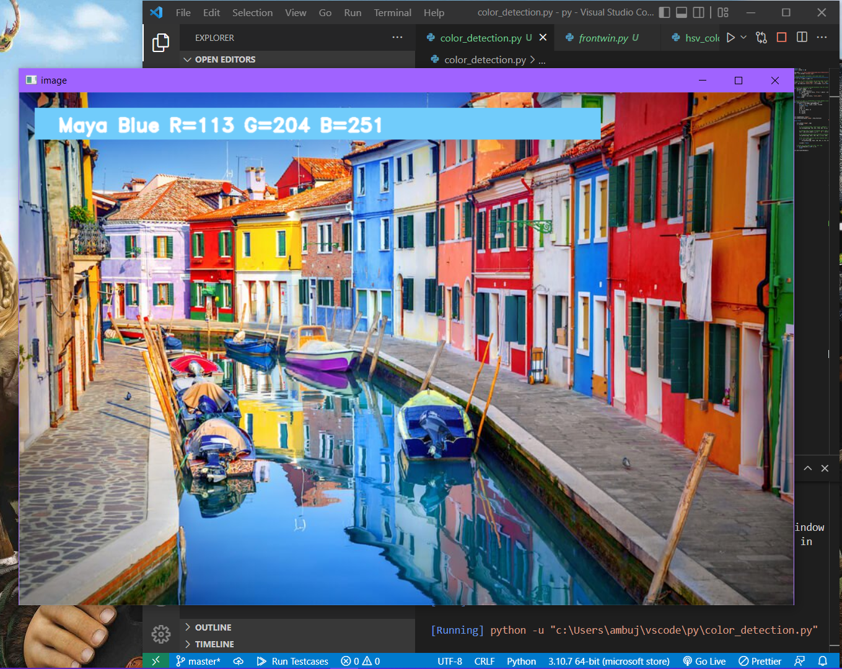

Slide 22
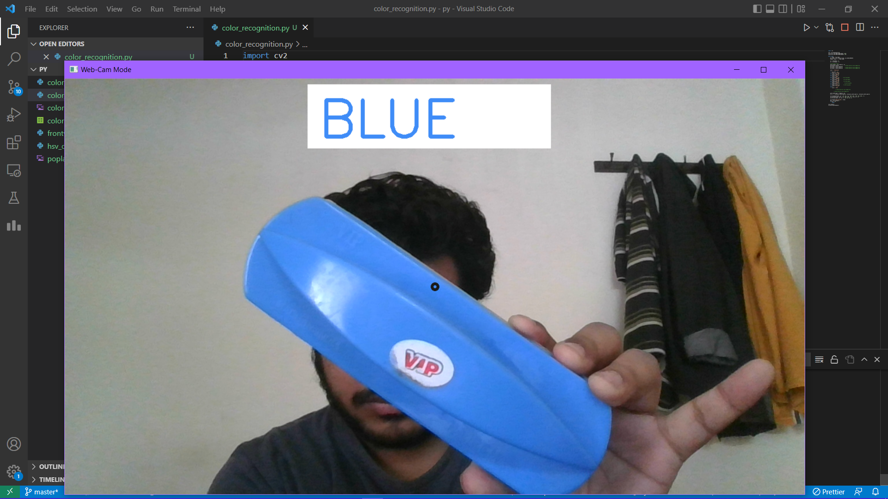

Slide 23
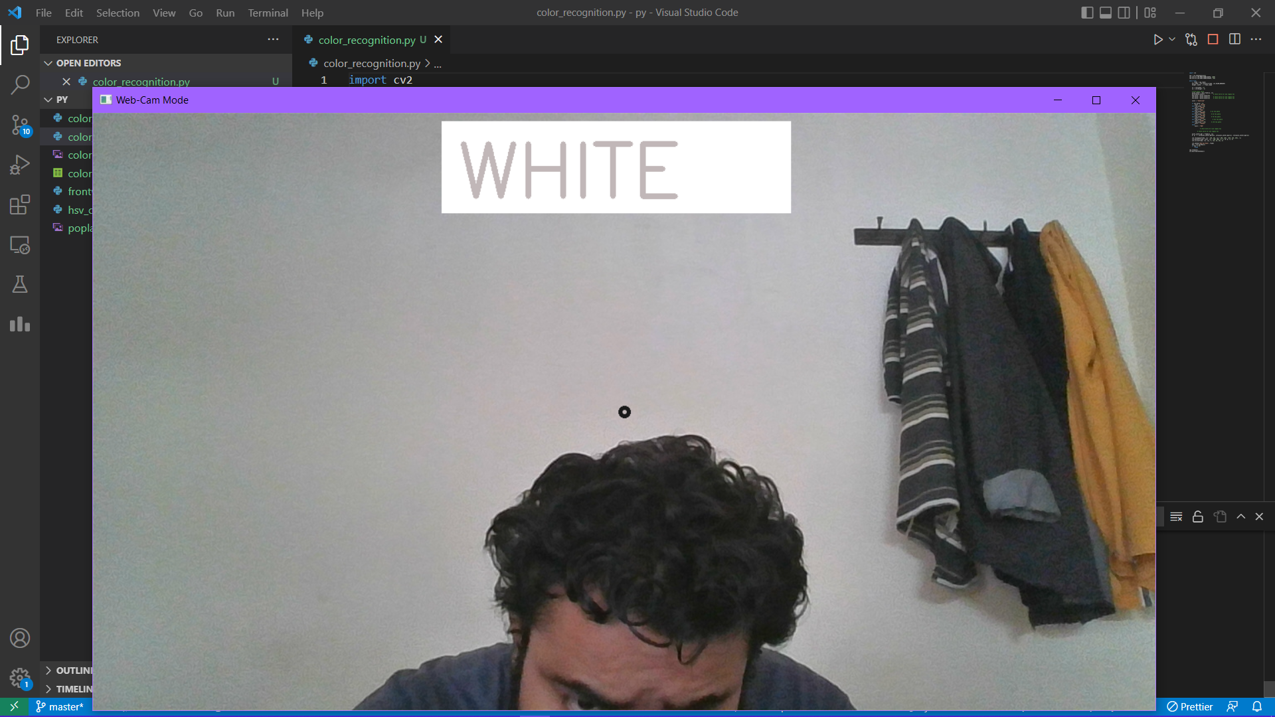

Slide 24
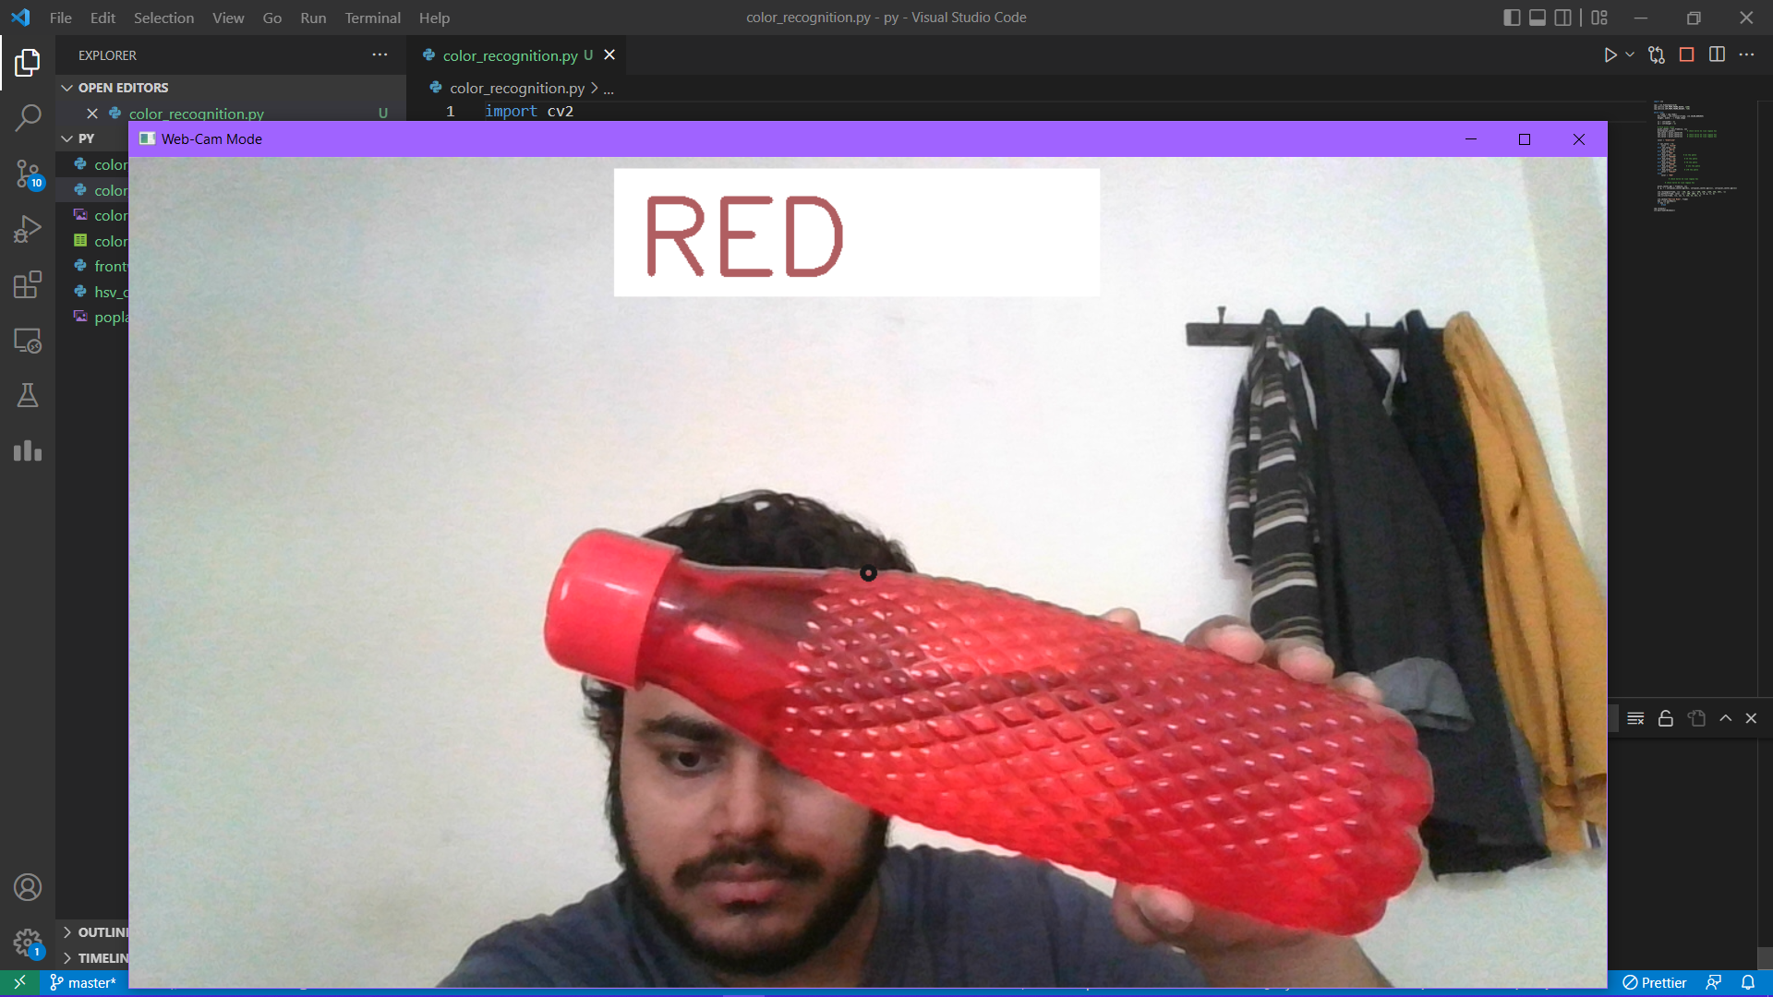

Slide 25
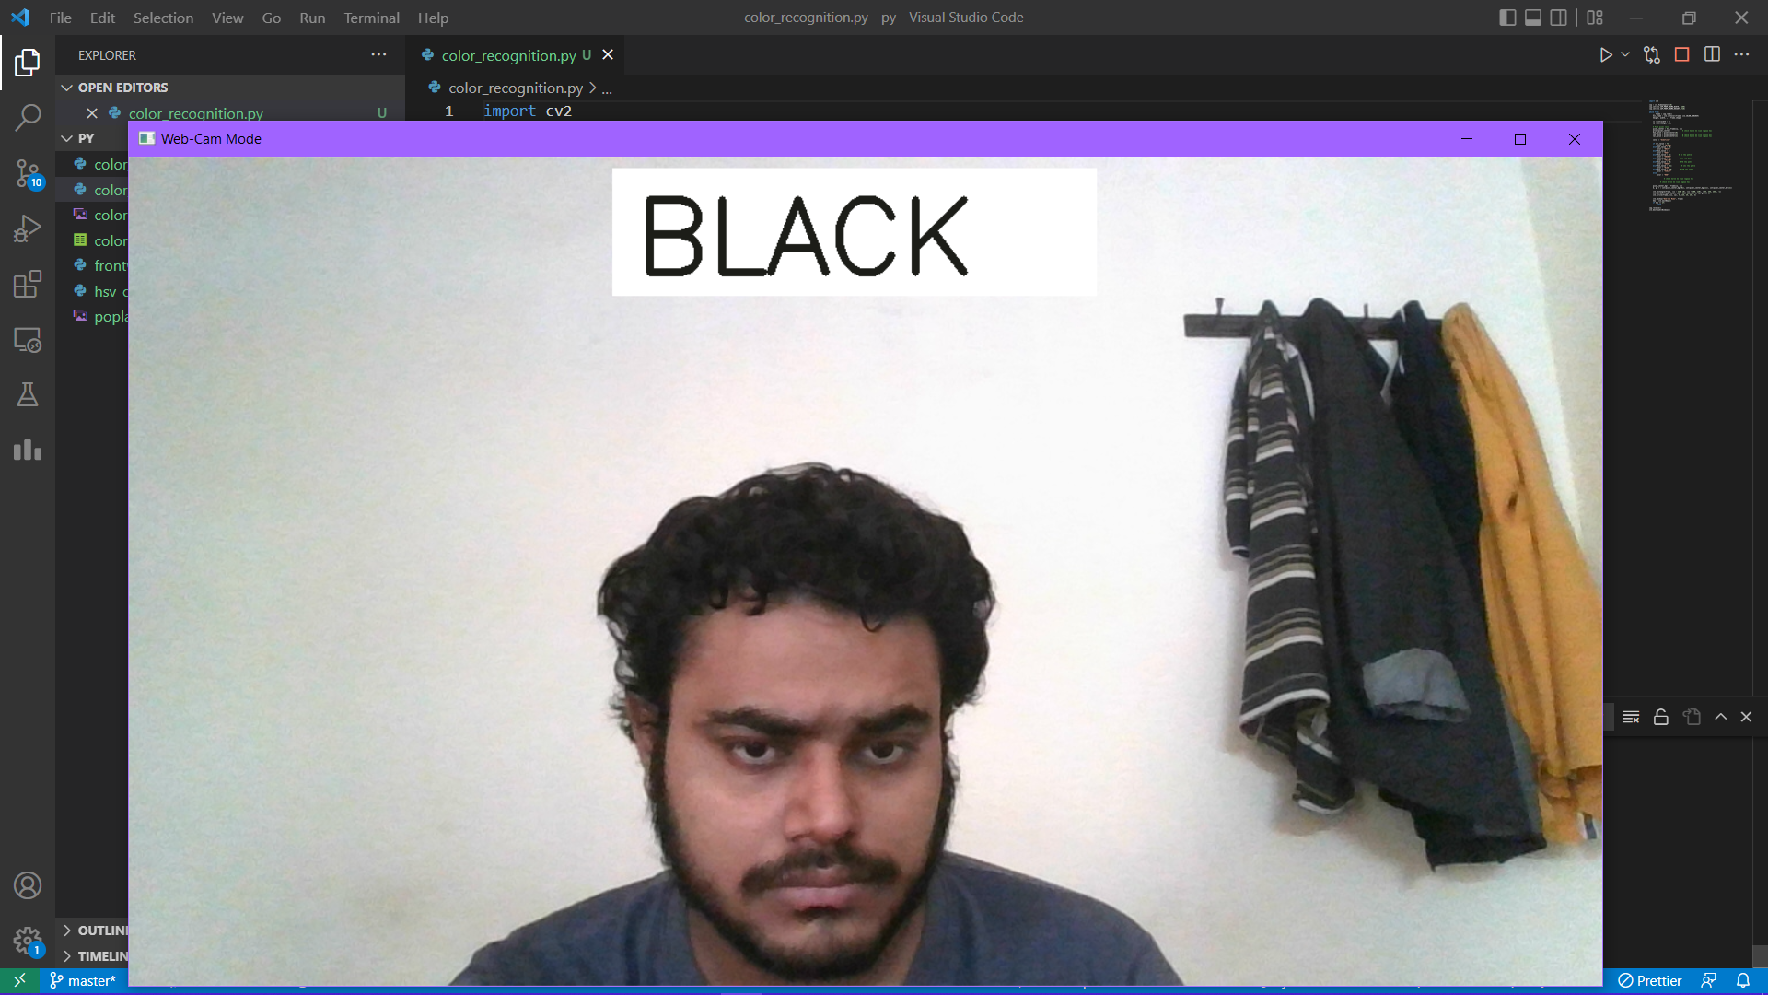

Slide 26
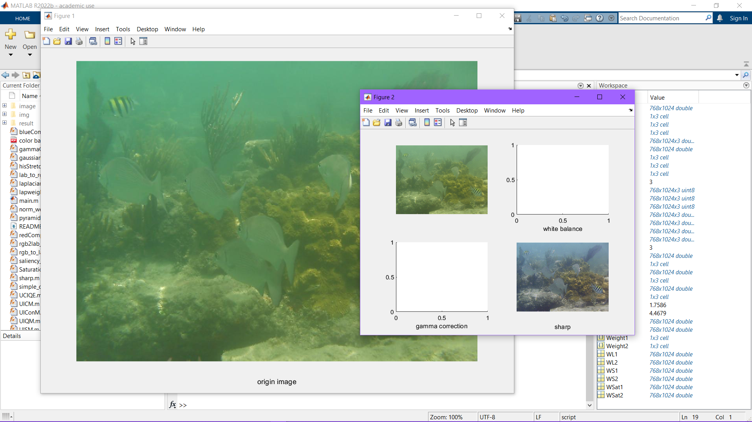

Slide 27
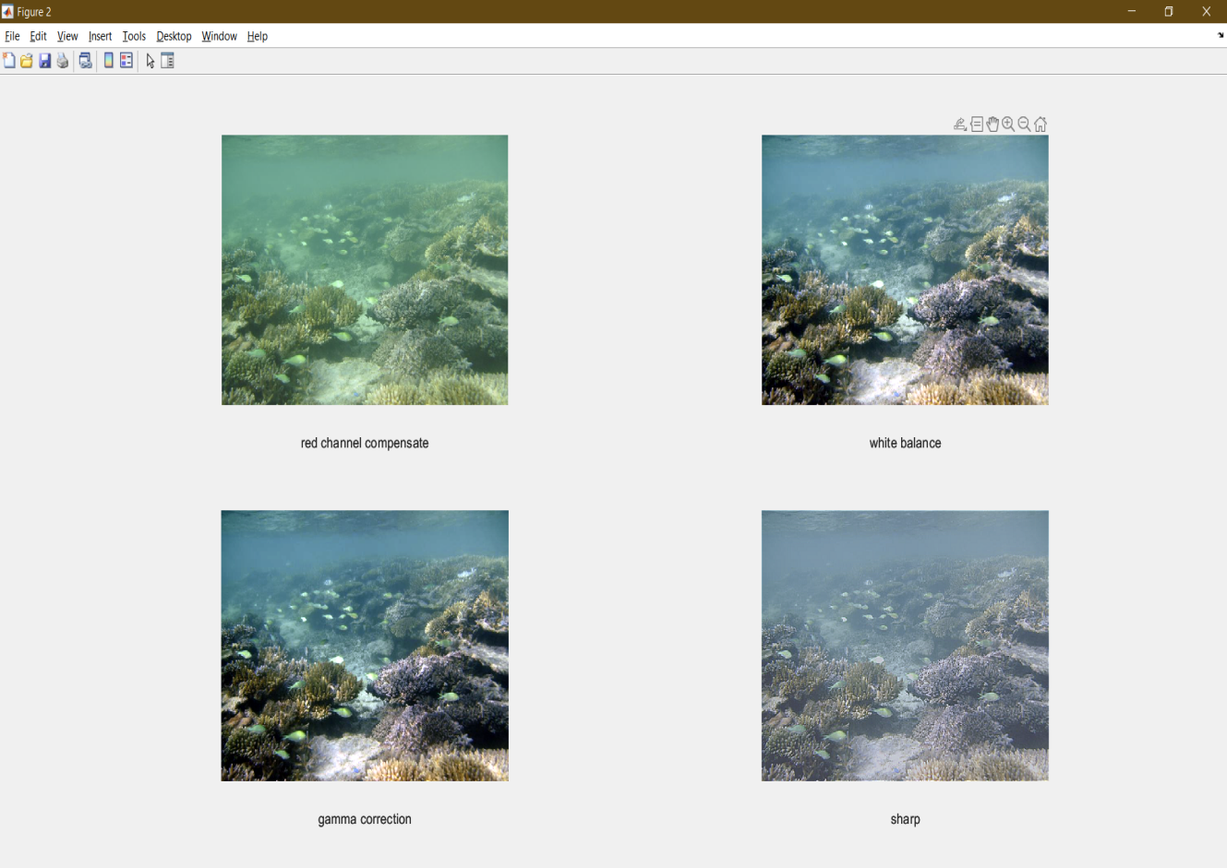

Slide 28
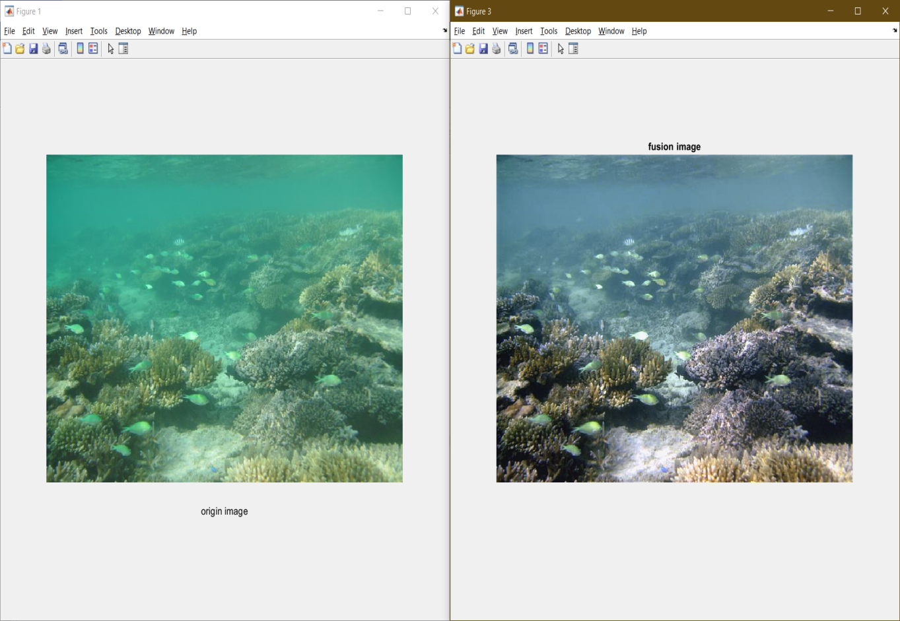

Slide 29
REFRENCES
G.M. Snoek, “Evaluating Color Descriptors for Object and Scene Recognition”, IEEE TRANSACTIONS ON PATTERN ANALYSIS AND MACHINE INTELLIGENCE, VOL. 32, NO. 9, SEPTEMBER 2010.
Kok -Meng Lee, “Effects of Classification Methods on Color-Based Feature Detection with Food Processing Applications”, IEEE TRANSACTIONS ON AUTOMATION SCIENCE AND ENGINEERING, VOL. 4, NO. 1,jan 2007.
Weiming Hu, Xue Zhou, “Active Contour Based Visual Tracking by Integrating Colors, Shapes and Motions”, IEEE TRANSACTIONS ON IMAGE PROCESSING, VOL. 22, NO. 5, MAY 2013
4.G. L. Foresti, “Visual inspection of sea bottom structures by an autonomous underwater vehicle,” IEEE Trans. Syst., Man, Cybern. B, Cybern., vol. 31, no. 5, pp. 691–705, Oct. 2001. 5.H. Lu, Y. Li, L. Zhang, and S. Serikawa, “Contrast enhancement for images in turbid water,” J. Opt. Soc. Amer. A, Opt. Image Sci., vol. 32, no. 5, pp. 886–893, May 2015. 6.P. Burt and T. Adelson, “The laplacian pyramid as a compact image code,” IEEE Trans. Commun., vol. COM-31, no. 4, pp. 532–540, Apr. 1983.

